Slide 1
Microservice Communication
Lecturer: Ngo Huy Bien
Software Engineering Department
Faculty of Information Technology
VNUHCM - University of Science
Ho Chi Minh City, Vietnam
nhbien@fit.hcmus.edu.vn

Slide 2

Objectives
To connect microservices one another.

Slide 3

Contents

Slide 4

References
https://martinfowler.com/articles/microservices.html
Cloves Carneiro and Tim Schmelmer (2016). Microservices From Day One. Apress.
Michael T. Nygard (2018). Release It - Design and Deploy Production-Ready Software. Pragmatic Bookshelf.
Gaurav Aroraa (2017). Building Microservices with .NET Core 2.0. Packt Publishing.

Slide 5
Communication Protocols [1]
The two protocols used most commonly are HTTP request-response with resource API's and lightweight messaging.
The best expression of the first is
be of the web, not behind the web
-- Ian Robinson
The infrastructure chosen is typically dumb (dumb as in acts as a message router only) - simple implementations such as RabbitMQ or ZeroMQ don't do much more than provide a reliable asynchronous fabric - the smarts still live in the end points that are producing and consuming messages; in the services.

Slide 6
Explicit Communication [2]
By contrast, microservice architectures tend to work with very explicitly published, small and rather simple contracts between the single service applications.
RESTful microservice APIs often favor coarse-grained, or even batch, endpoints to reduce the impact of the unavoidable latency introduced by out-of-process and HTTP calls, or the transfer of documents via lightweight ESBs.

Slide 7


Slide 8
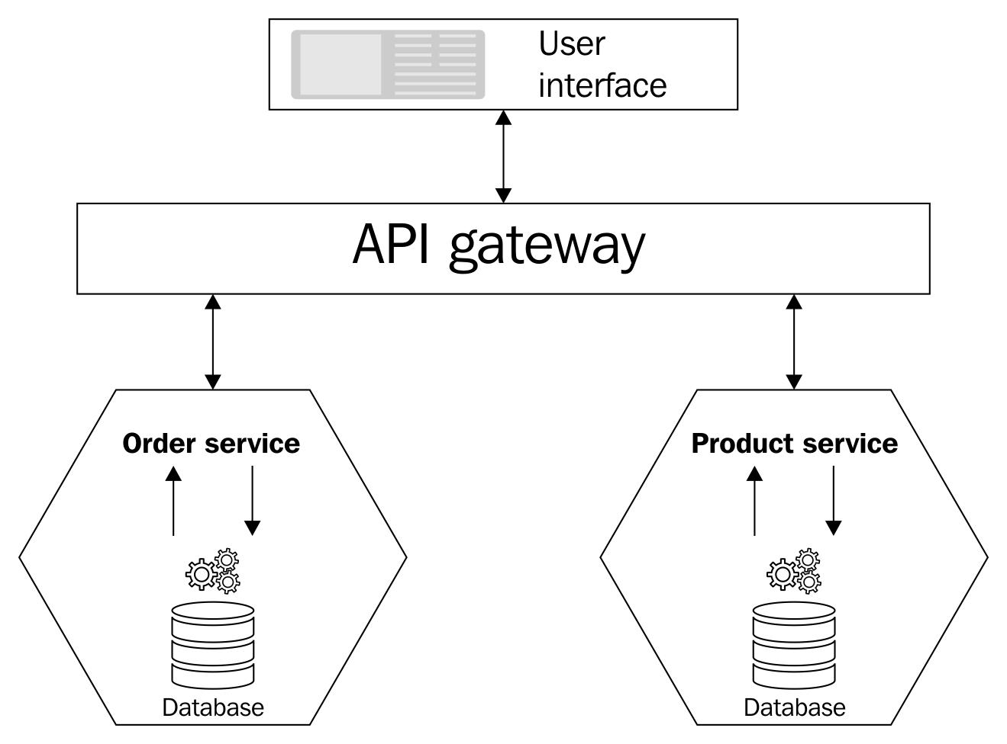
API Gateway

Slide 9
Azure API Management (aka API Gateway)
It acts as a proxy between client applications and services.
It is responsible for the following functionalities:
Accepting API calls and routes them to your backends
Verifying API keys, JWT tokens, and certificates
Supporting Auth through Azure AD and the OAuth 2.0 access token
Enforcing usage quotas and rate limits
Transforming your API on the fly without code modifications
Caching backend responses wherever they are set up
Logging call metadata for analytics purposes

Slide 10
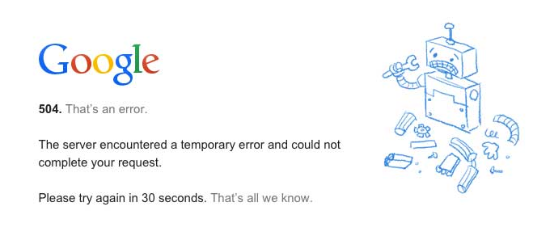
Circuit Breaker (I)
https://martinfowler.com/bliki/CircuitBreaker.html
One of the big differences between in-memory calls and remote calls is that remote calls can fail, or hang without a response until some timeout limit is reached.
What's worse if you have many callers on a unresponsive supplier, then you can run out of critical resources leading to cascading failures across multiple systems.

Slide 11
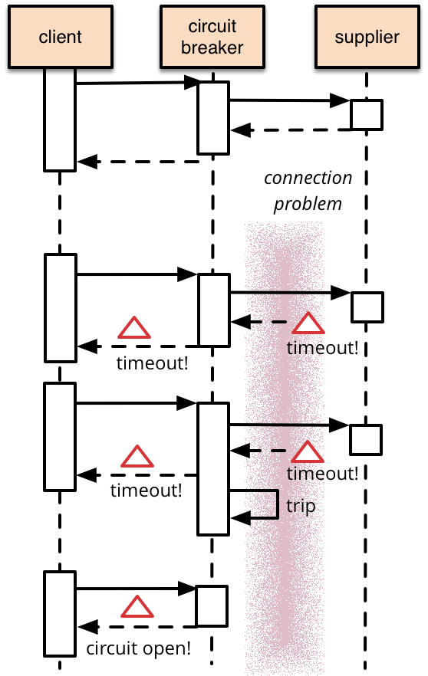
Circuit Breaker (II)
The basic idea behind the circuit breaker that you wrap a protected function call in a circuit breaker object, which monitors for failures.
Once the failures reach a certain threshold, the circuit breaker trips, and all further calls to the circuit breaker return with an error, without the protected call being made at all.
Usually you'll also want some kind of monitor alert if the circuit breaker trips.

Slide 12
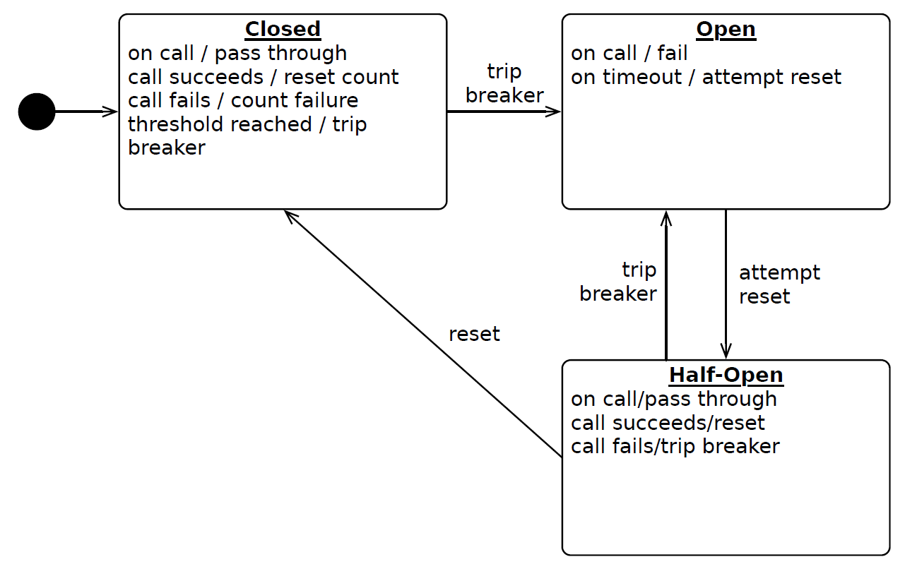
Circuit Breaker [3]
When the circuit is “open,” calls to the circuit breaker fail immediately, without any attempt to execute the real operation.
After a suitable amount of time, the circuit breaker decides that the operation has a chance of succeeding, so it goes into the “half-open” state. In this state, the next call to the circuit breaker is allowed to execute the dangerous operation.
Should the call succeed, the circuit breaker resets and returns to the “closed” state, ready for more routine operation.
If this trial call fails, however, the circuit breaker returns to the open state until another timeout elapses.

Slide 13

Circuit Breaker Example Code?

Slide 14

Consumer-Driven Contracts
https://martinfowler.com/articles/consumerDrivenContracts.html
Evolving a Service: An Example
In our example, after the ProductSearch service has been in production for some time, a second reseller considers using it, but asks that a Description field be added to each product.
First, we could modify our original schema and require each consumer to update its copy of the schema in order correctly to validate search results.
Alternatively, we could choose to add a second operation and schema to the service provider on behalf of the new consumer, and maintain the original operation and schema on behalf of the existing consumers.

Slide 15
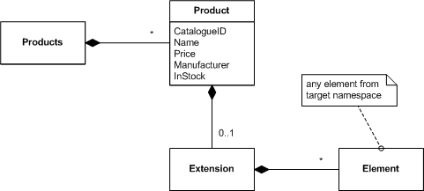
Extension Points
Now when we receive a change request to add a description to each product, we can publish a new schema with an additional Description element that the provider inserts into the extension container.
This allows the ProductSearch service to return results that include product descriptions, and consumers using the new schema to validate the entire document.
Consumers using the old schema will not break, though they will not process the description.

Slide 16
Contract Testing
https://martinfowler.com/bliki/ContractTest.html
A test double is handy, it stops your own tests from being slow and unreliable.
But testing against a double always raises the question of whether the double is indeed an accurate representation of the external service, and what happens if the external service changes its contract?
A good way to deal with this is to run your own tests against the double, but to periodically run a separate set of contract tests that checks all the calls against your test doubles return the same results as a call to the external service would.

Slide 17
Pact
https://docs.pact.io/
https://github.com/pact-foundation/pact-net
Pact is a code-first tool for testing HTTP and message integrations using contract tests.
Contract tests assert that inter-application messages conform to a shared understanding that is documented in a contract. Without contract testing, the only way to ensure that applications will work correctly together is by using expensive and brittle integration tests.

Slide 19
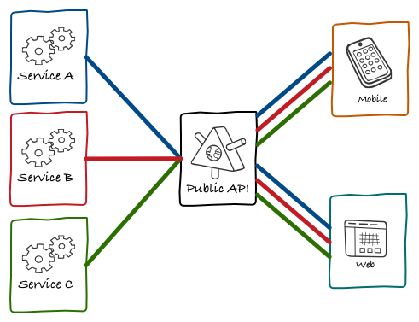
One Public API Problems
https://philcalcado.com/2015/09/18/the_back_end_for_front_end_pattern_bff.html
If we were to use the public API only, there was nothing that we could offer in our platform that wouldn’t be available for third-party API clients.
To empower third-party developers to build interesting integrations, you need to design an API that makes no assumptions about how the data is going to be used. This results in very fine-grained endpoints.
Even without the monolith, we still had a bottleneck on the API.

Slide 20
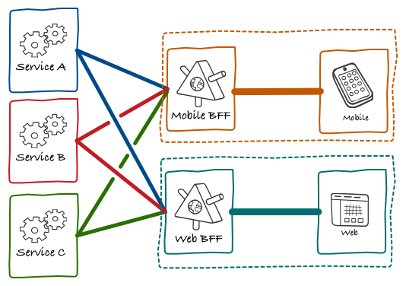
The Back-end for Front-end Pattern
There was a lot of duplicated code across all BFFs fetching and merging data for them.
The simple version of BFF

Slide 21
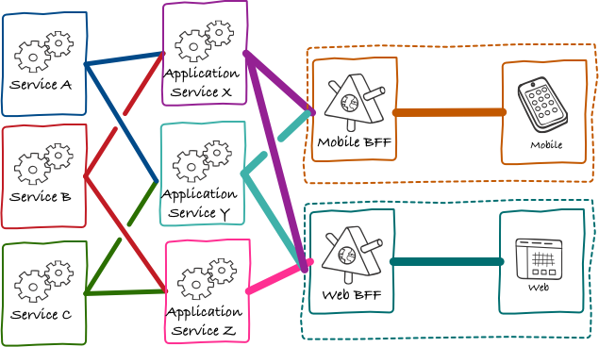
Full Version of BFF
Moving towards an architecture where most of the core objects understood by users had their own microservice backing them.

Slide 23
OpenAPI Specification
https://swagger.io/docs/specification/v3_0/about/
OpenAPI Specification (formerly Swagger Specification) is an API description format for REST APIs. An OpenAPI file allows you to describe your entire API, including:
Available endpoints (/users) and operations on each endpoint (GET /users, POST /users)
Operation parameters Input and output for each operation
Authentication methods
Contact information, license, terms of use, and other information.
API specifications can be written in YAML or JSON.

Slide 24
Why OpenAPI Specification?
OpenAPI Specification is used as a machine-readable model of the API, enabling automated black-box generation of test inputs and response oracles.

Slide 25

Thank You & See You Again

